Slide 1
EPIC SmartForms and FlowSheets
a compiled library of Epic SmartForms/Flowsheets from ELHS partnered sites. There are versatile versions of existing forms for providers reporting patients’ outcomes

Slide 2
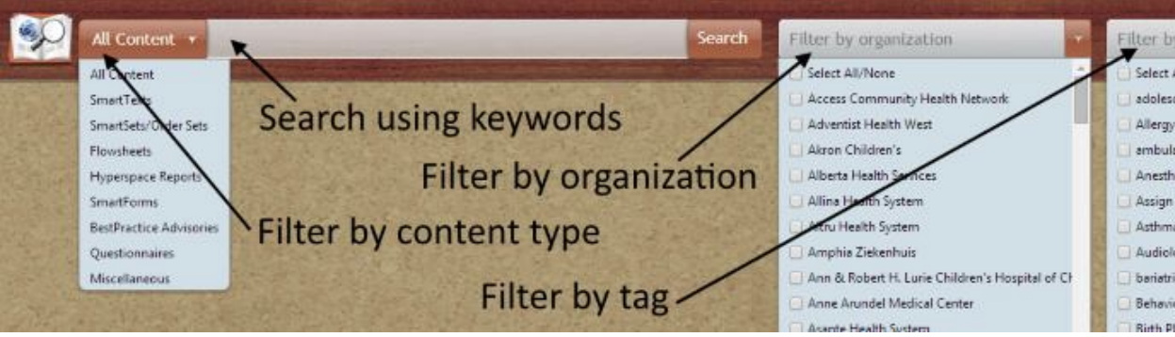
EPIC Community Library
userweb.epic.com
Online resource among Epic users
451 Organization

Slide 3
ELHS EPIC Users Efforts
10 Epic User Groups within ELHS
Monthly meetings conducted among all ELHS affiliated sites
Current Focus:
standardize Seizure documentation for SmartForm/FlowSheet among sites
Turbocharger Request to EPIC to house Standard Seizure Documentation SmartForm to be live inside the EPIC Community Library

Slide 4
Provider Filled Seizure Documentation
The following sites documentation mechanism are included in this presentation:
Colorado University Anschutz (CUA) → Built in flowsheet
Massachusetts General Brigham (MGB) → EPIC SmartForm
Akron Children Hospital (ACH) → EPIC SmartForm
UC Health → EPIC SmartForm
University of Texas South West Children Hospital (UTSWCH) → Flowsheet
Children Hospital of Philadelphia → SmartForm
Cincinnati Children Hospital Comprehensive Epilepsy Center (CCHCMC) →

Slide 5
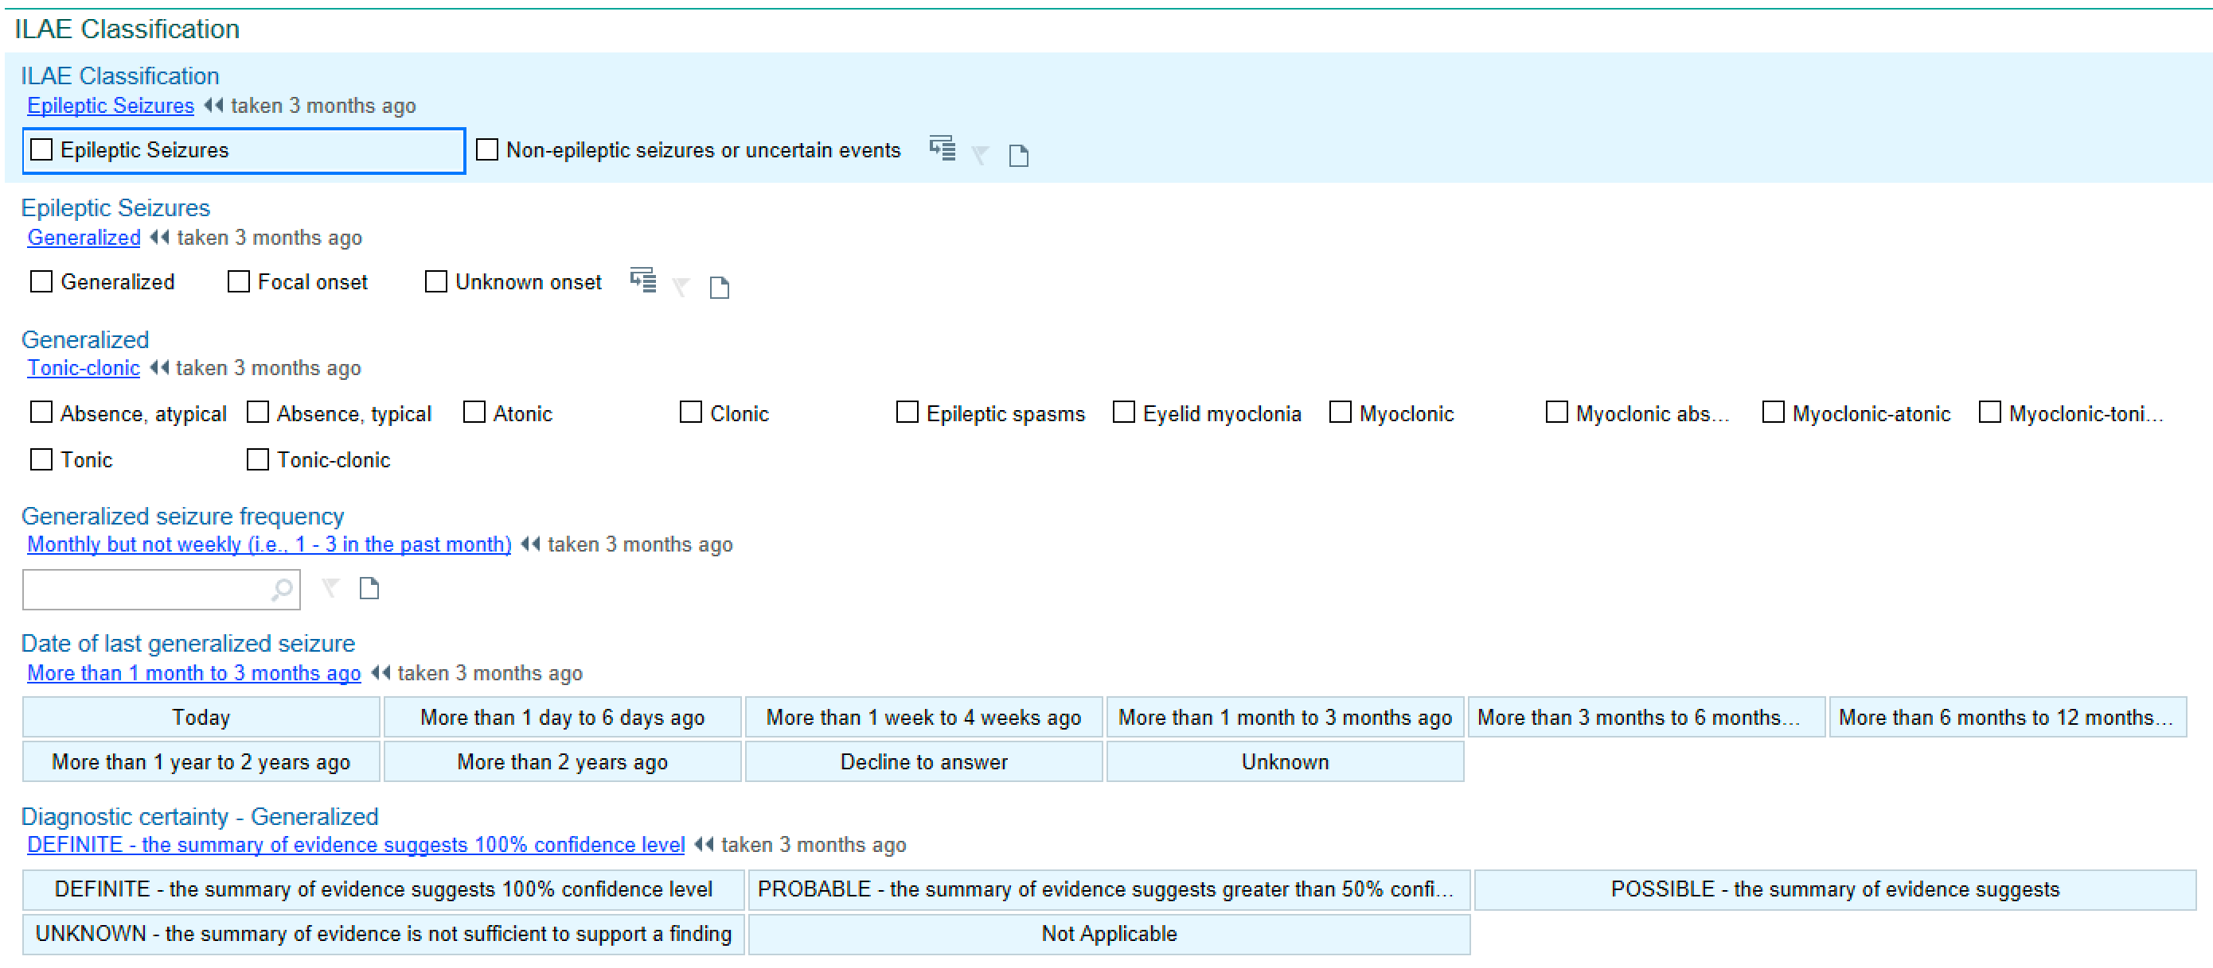
Colorado University Anschutz
SEIZURE FREQUENCY DOCUMENTATION
Notes:
SC: provided by PI of CUA

Slide 6
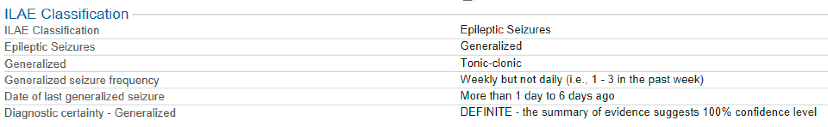
Colorado University Anschutz
ILEA CLASSIFICATION FLOWSHEET

Slide 7
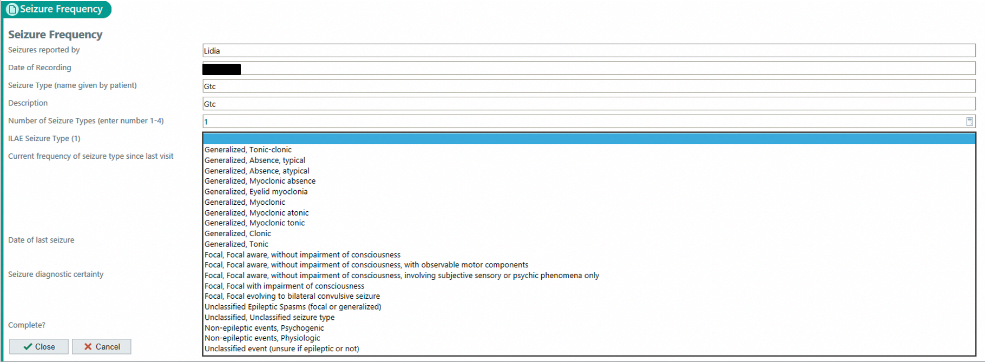
Massachusetts General Brigham (MGB)
black
hello
Notes:
These were screenshot provided within our lab but the form lives in the EPIC community Library → MGB AMB NEU SEIZURE FREQUENCY

Slide 8
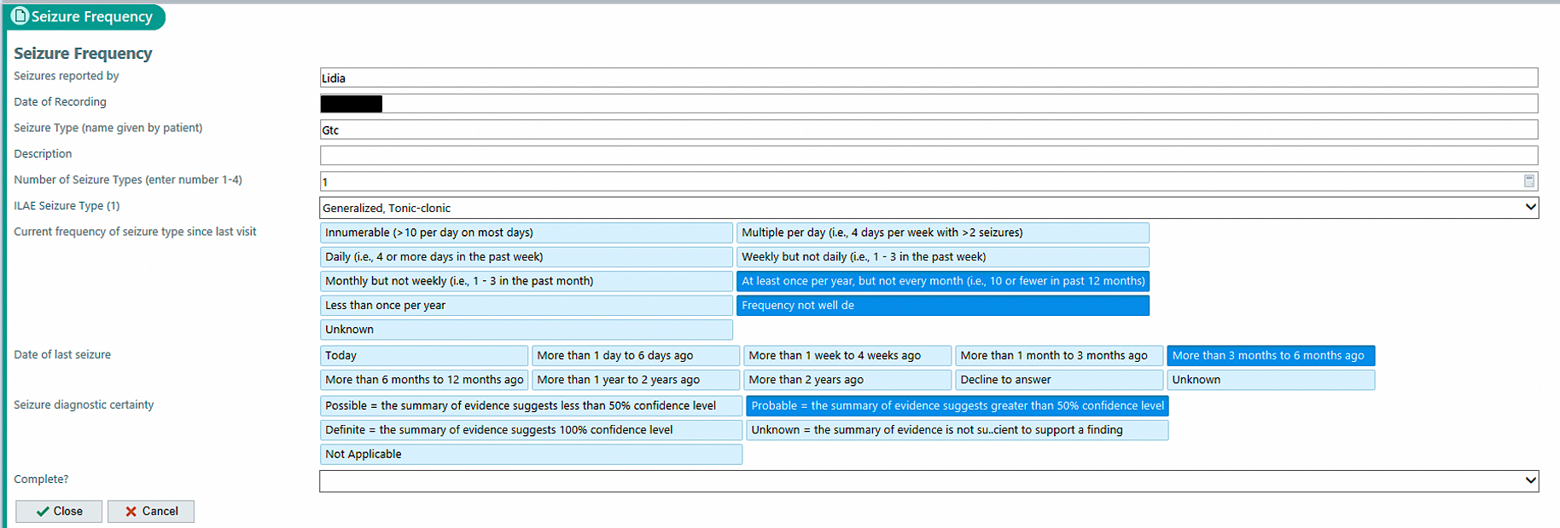
black

Slide 9
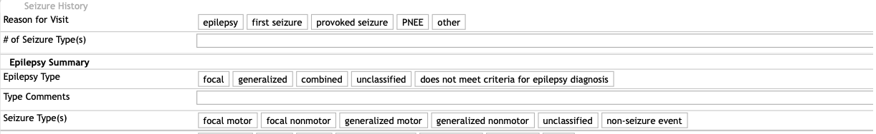
AKRON CHILDREN HOSPITAL (ACH)
SEIZURE FREQUENCY REPORTING FORMAT; OBRAINED FROM THE EPIC COMMUNITY LIBRARY SMARTSHEETS
Notes:
Pulled Directly from the EPIC community library → ACH NEURO SEIZURE HPI

Slide 10
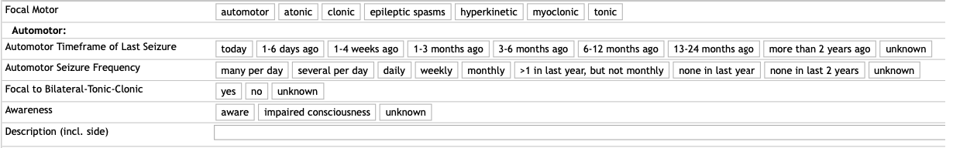
Akron Children Hospital
EACH SEIZURE TYPE FOLLOWS THIS FORMAT:
  Subtype
  Timeframe of Last Seizure
  Seizure Frequency,
  Focal to Bilateral- Tonic-Clonic
  Awareness
  Description
Notes:
Pulled Directly from the EPIC community library → ACH NEURO SEIZURE HPI

Slide 11
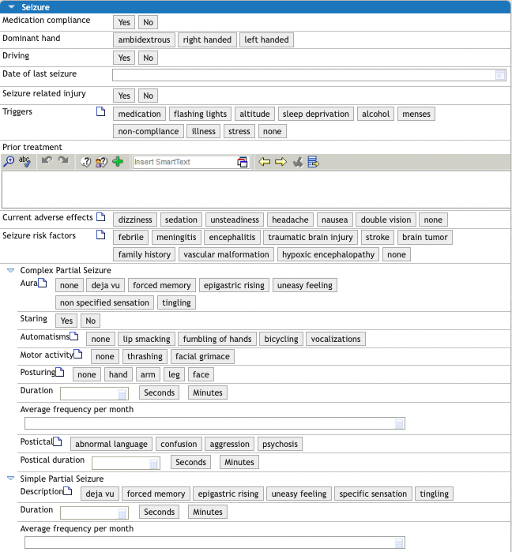
UC Health
University of Cincinnati Gardner Neuroscience
Notes:
Pt.1 Pulled Directly from the EPIC library → UCH NEU HPI SEIZURES

Slide 12
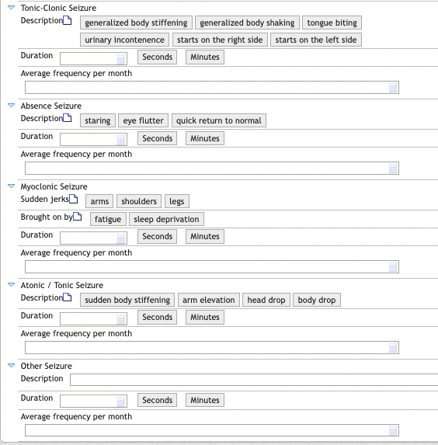
UC Health
Seizure ILEA Documentation
Notes:
pt.2 Pulled Directly from the EPIC library → UCH NEU HPI SEIZURES

Slide 13
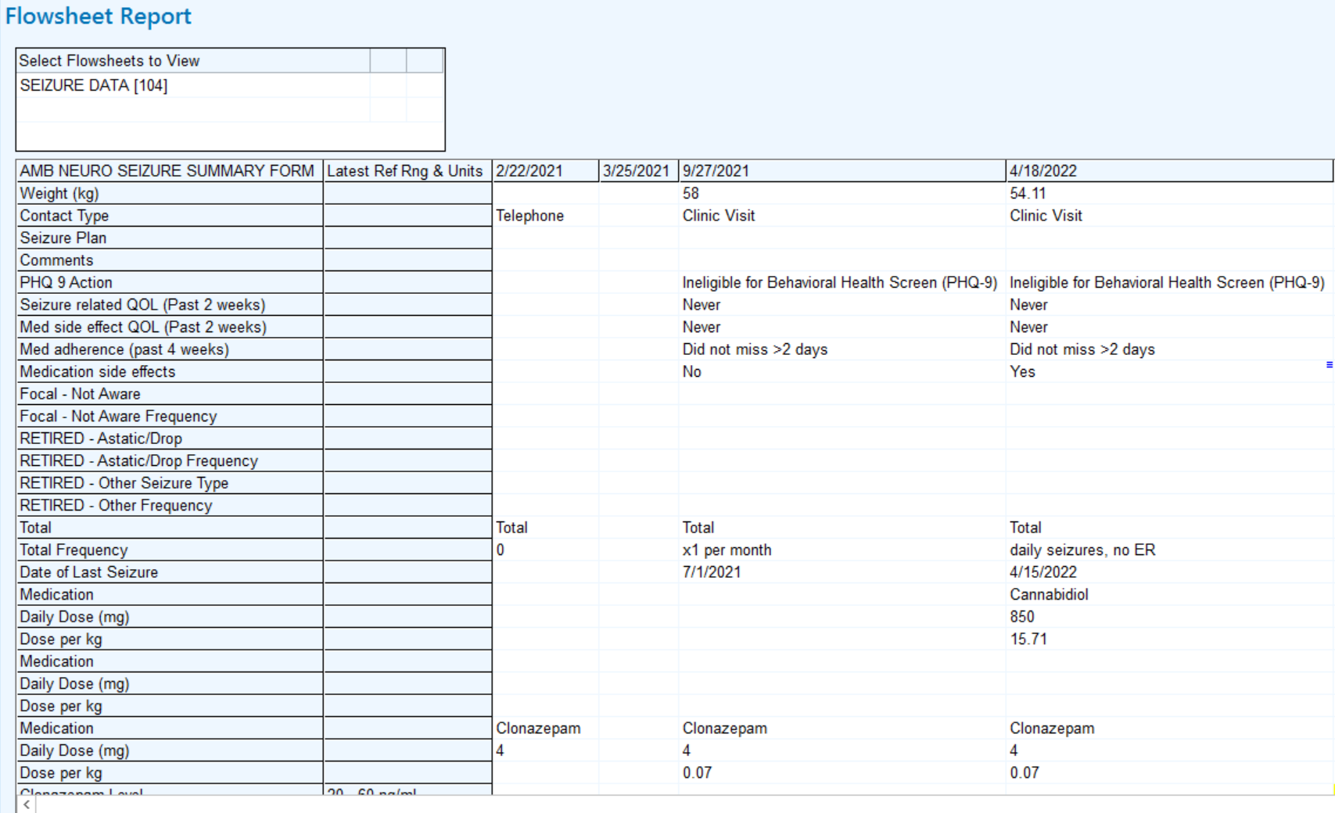
UTSWCH
University of Texas Southwest Children Hospital

Slide 14
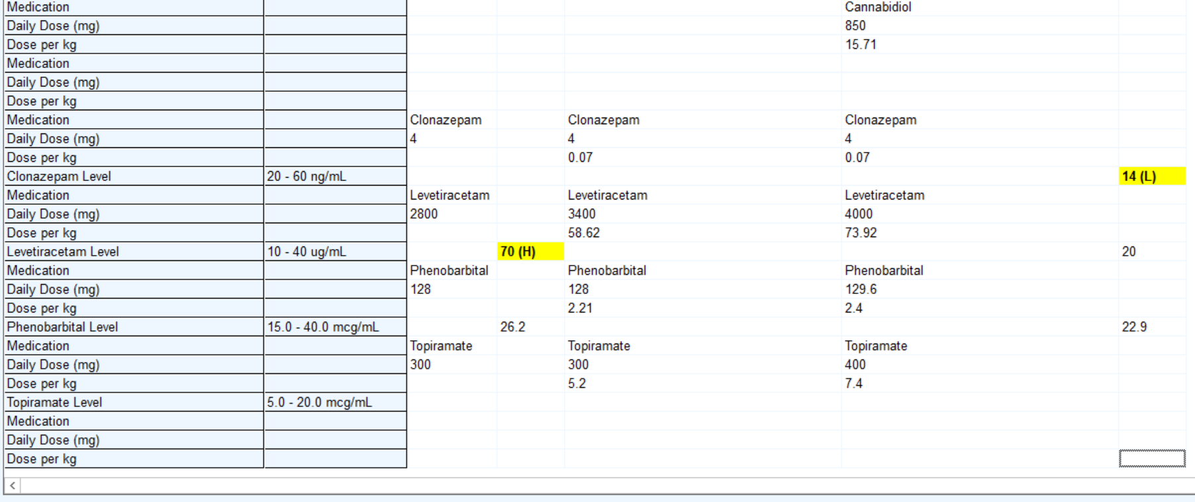
UTSWCH
Flowsheet Report Mechanism

Slide 15
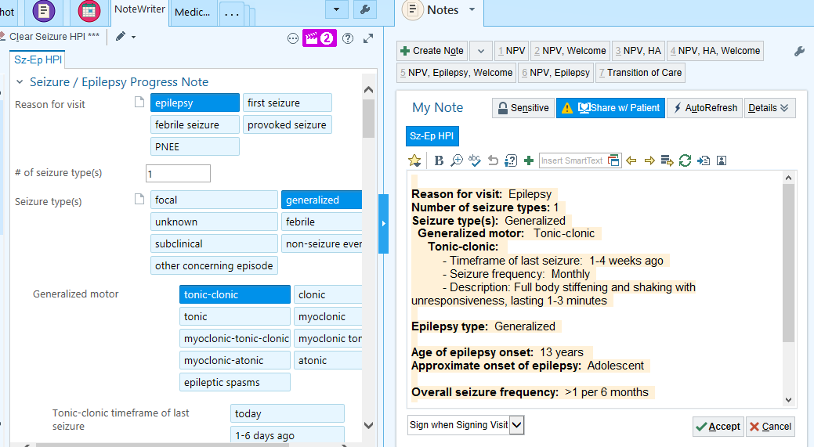
CHOP
Children Hospital of Philadelphia

Slide 16
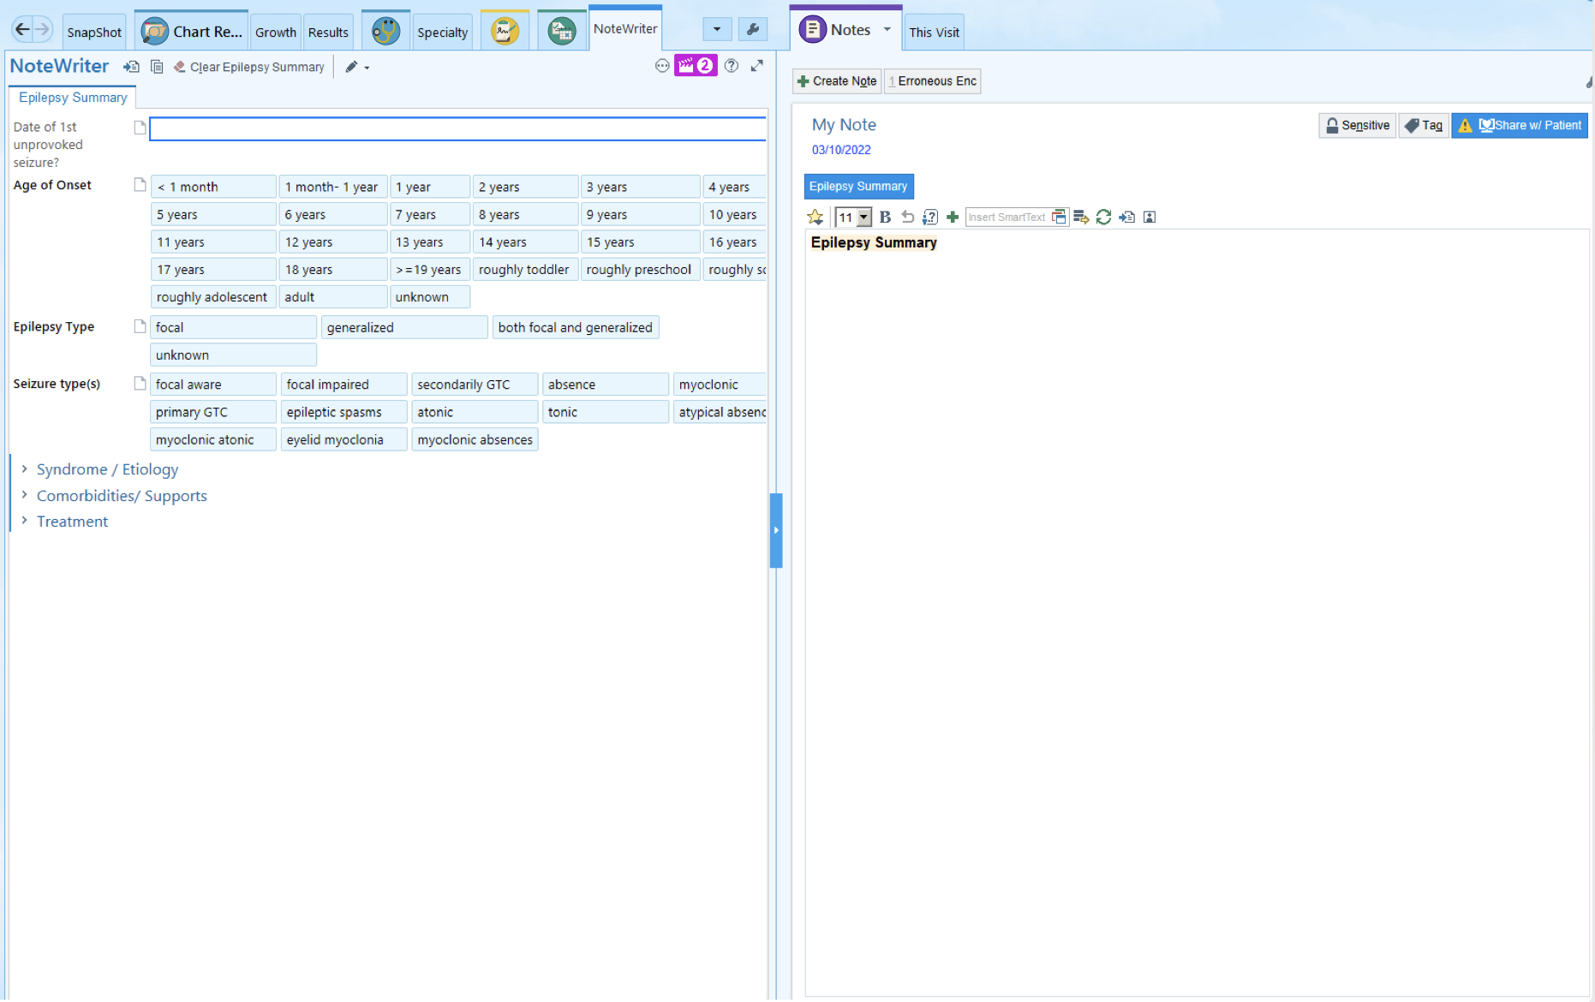
CCHMC
Cincinnati Children Hospital Comprehensive Epilepsy Center

Slide 17
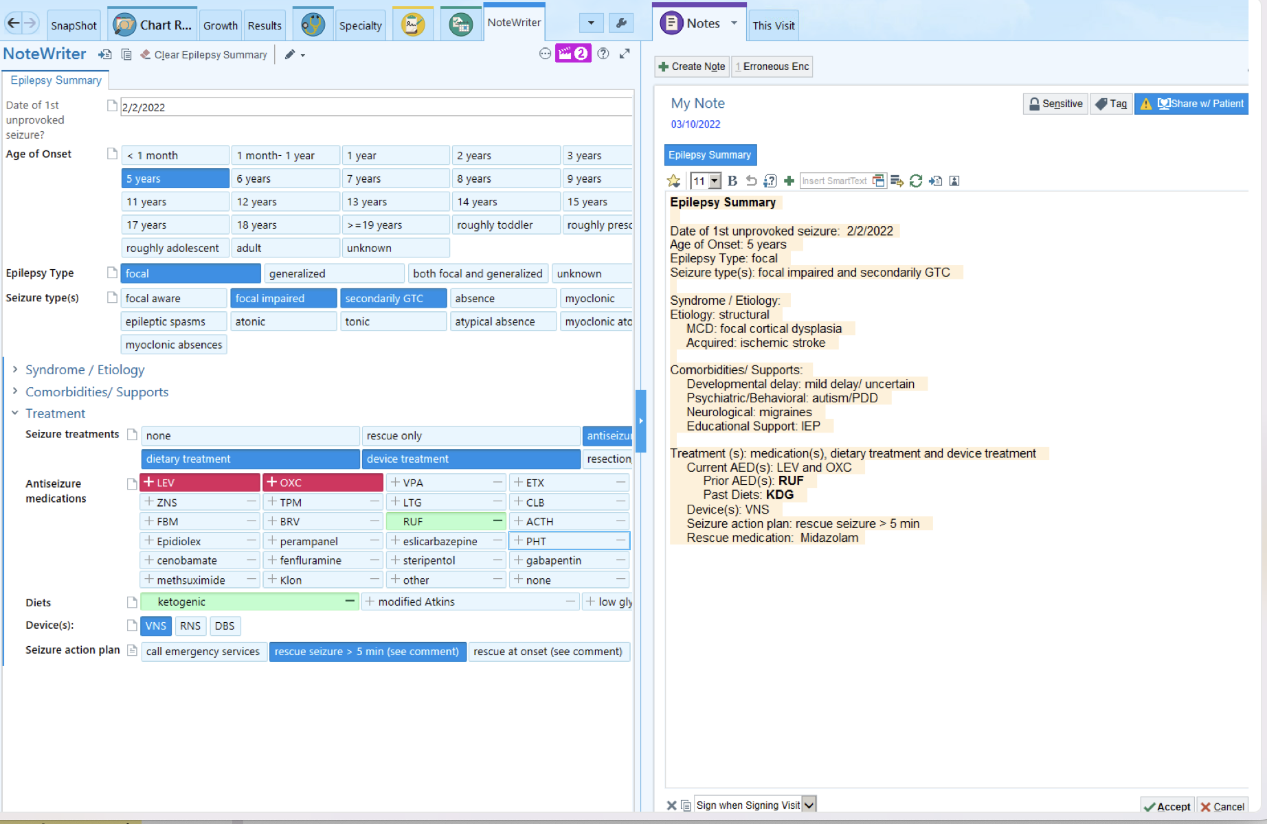
CCHMC
Notes Format within EPIC as documentation mechanism

